Slide 1

Healthier Cocktails and Treats for the Holidays
Liz Jones
MAOL, BA, RYT, CPT
Wellness Coordinator, Personal Trainer,
Wellness Consultant and Coach

Slide 2
My philosophy
With all of the information out there, how is anyone, especially the “average Joe (or Josephine)” supposed to figure out what is best for them to maintain a healthy lifestyle? What I tell people when I meet with them as a trainer or wellness coach and nutritionist is that I don’t personally advocate for “diets” I believe in eating for nutrition.

Slide 3
Eat for nutrition first- not a “diet”
Eating is not something that you can stop doing, it needs to be something that you incorporate for life.
Drug addicts stop using drugs, smokers stop smoking. Food addicts have to find ways to make healthy choices when eating every day.
You still need to enjoy food. Eating should not be a “demerit” system.

Slide 4

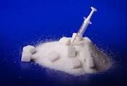
The good, the bad, the ugly
  Good:
  raw, local honey
  Stevia
  Agave nectar
  REAL maple syrup
  BEST: use unsweetened apple sauce, beets, bananas to recipes for natural sweetness
  Still needs to be used in moderation
  Bad:
  processed honey
  Ugly:
  white sugar
  high fructose corn syrup
  Chemically created or modified sweeteners
  If you are diabetic or at risk for diabetes, discuss how much sugar you can consume and what types they recommend

Slide 5
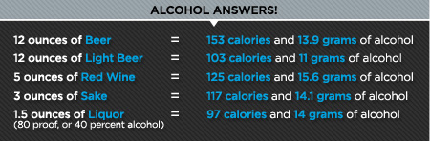
Make better choices
If you choose to drink alcohol, there are some ways you can make cocktails “healthier” than the sugar in pre-made mixes, creams, and salt.

Slide 6
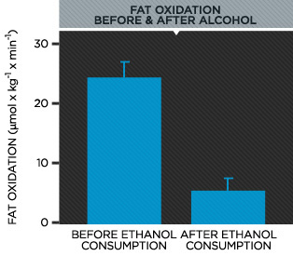

Slide 7
A “regular” Mojito
Nutrition Facts
Serving Size 1 cocktail
Amount Per Serving
Calories from Fat 0 Calories 217
% Daily Values*
Total Fat 0.04g |  | 0%
 | Saturated Fat 0.005g | 0%
 | Polyunsaturated Fat 0.012g
 | Monounsaturated Fat 0.002g
Cholesterol 0mg |  | 0%
Sodium 30mg |  | 1%
Potassium 24mg
Total Carbohydrate 24.94g |  | 8%
 | Dietary Fiber 0.5g | 2%
 | Sugars 23.47g
Protein 0.14g
Vitamin A 1% |  | Vitamin C 9%
Calcium 2% |  | Iron 1%
* | Percent Daily Values are based on a 2000 calorie diet. Your daily values may be higher or lower depending on your calorie needs. Nutrition Values are based on USDA Nutrient Database SR18
217 calories
22.47 grams of sugar

Slide 8
Mojito with agave
Amount Per Serving
Calories |  | 160.17
Calories From Fat (0%) |  | 0.09
 |  | % Daily Value
Total Fat 0.01g |  | 0%
Saturated Fat 0.00g |  | 0%
Cholesterol 0.00mg |  | 0%
Sodium 38.00mg |  | 2%
Potassium 22.37mg |  | 1%
Carbohydrates 17.29g |  | 6%
Dietary Fiber 0.06g |  | 0%
Sugar 16.26g
Sugar Alcohols 0.00g
Net Carbohydrates 17.23g
Protein 0.06g |  | 0%
160 calories
16.26 grams of sugar
(If you use Stevia instead it will be under 100 calories)

Slide 9
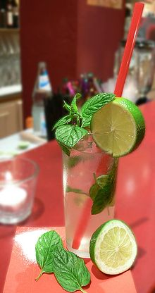
Recipes
Mojito
Mint
Limes
White rum
Stevia or agave nectar
Soda water
Muddle mint with some ice and lime juice in a bullet. Add Stevia or Agave nectar to taste. Add 1 shot of rum. Blend.
Pour over ice. Add soda water. Squeeze limes on top and add limes. Garnish with mint.

Slide 10

A “regular” margarita
Choose to enjoy this refreshing classic on the rocks and you will consume 1113 calories, no fat, 50 grams of carbohydrates and no protein.
Not counting the salt on the rim, you will consume almost two times the RDA for sodium and 31 grams of sugar.

Slide 11

Agave and orange juice margarita
Calories: 184
Sugar: 9 grams

Slide 12

Margarita
2 ounces (1/4 cup) tequila
1½ ounces (3 tablespoons/about 1½ small limes) fresh lime juice
1 ounce (2 tablespoons/about ½ of a medium orange) fresh orange juice
1 teaspoon light agave nectar
1 lime wedge or round, for garnish
Instructions
Optional: salt rim
Fill a small cocktail shaker with ice. Pour in the tequila, freshly squeezed lime and orange juice and agave nectar. Put on the lid and shake for 30 seconds. Strain the liquid into your glass and garnish with a slice of lime.

Slide 13
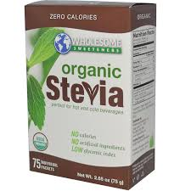
Stevia is a great, low calorie option

Slide 14

better choices
Merlot
Brut
Bloody Mary (low sodium or homemade mix)
Vodka Soda (choose low sodium soda water)

Slide 15

Merlot
Calories | 123 Cal | 6.15 %
Calories from Fat | 0 Cal
Total Fat | 0 g | 0 %
Saturated Fat | 0 g | 0 %
Polyunsaturated Fat | 0 g
Monounsaturated Fat | 0 g
Cholestrol | 0 mg | 0 %
Sodium | 6 mg | 0 %
Potassium | 187 mg | 5 %
Total Carbohydrates | 3.69 g | 1 %
Dietary Fiber | 0 g | 0 %
Sugar | 0.91 g
 | 4 %

Slide 16

Brut
Brut is champagne speak for "dry" and signifies a lower sugar content, resulting in a glass of bubbly that only contains about 65 calories.

Slide 17

Bloody Mary
80 calories, 81% calories from alcohol
What’s typically in it: 1 oz vodka, 3 oz tomato juice, hot sauce, Worcestershire sauce (I use Braggs Aminos), lemon, celery
Nutrition Info: 80 calories, 9 g alcohol, 3 g sugar, 4 g carbs — 81% calories from alcohol.

Slide 18

Vodka Soda w. Lime
97 calories, 100% calories from alcohol
What’s typically in it: 1.5 oz vodka, 6.5 oz soda water, lime
Nutrition Info: 97 calories, 14 g alcohol, 0 g sugar, 0 g carbs — 100% calories from alcohol.

Slide 19
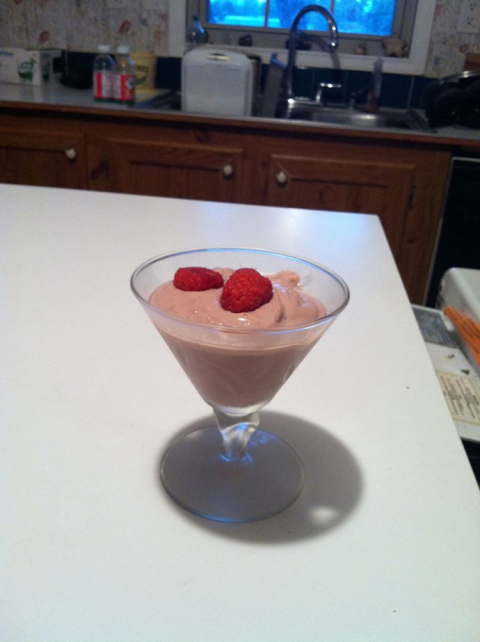
Fruit Mousse
Ingredients:
1 package extra firm Silken Lite tofu
1/3 cup maple syrup or sweetener of choice
3 tablespoons fresh fruit juice (see Variations)
Zest of one citrus (see Variations)
Instructions:
Blend all ingredients together.
Cover and refrigerate for an hour or more before serving.
Variations:
Orange Mousse: Use orange juice and zest
Lime Mousse: Use lime juice and zest
Mango Mousse: Use 2 fresh mangoes and zest of lime
Strawberry Mousse: Use 8 ounces fresh or frozen strawberries and zest of orange

Slide 20
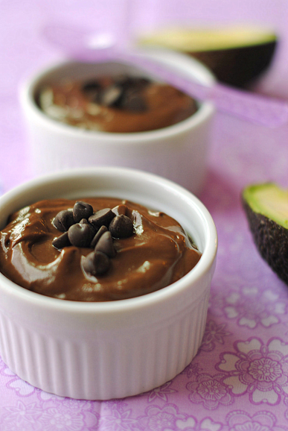
Avocado chocolate mousse
one ripe avocado
3T coconut milk
2T pure cocoa
2T agave nectar
1 slice of orange with the peel on (optional)
Blend in a bullet blender (add more coconut milk for creamier consistency, more cocoa for darker chocolate). Adjust agave nectar to taste (in moderation).

Slide 21

After the holidays

Slide 22
Healthy ways to detox your body
http://life.gaiam.com/article/10-ways-detoxify-your-body
Discuss with your medical professional if a cleanse is right for you.
I personally don’t do fasting cleanses, but do think that eating a vegetable and fruit based diet, along with increasing water intake and drinking tea can help to cleanse the body, give yourself a boost toward weight loss, and increase energy levels.

Slide 23
How do you start a detox?
First, lighten up your toxin load. Eliminate alcohol, coffee, cigarettes, refined sugars and saturated fats, all of which act as toxins in the body and are obstacles to your healing process. Also, minimize use of chemical-based household cleaners and personal health care products (cleansers, shampoos, deodorants and toothpastes), and substitute natural alternatives.

Slide 24
Toxic stress
Another deterrent to good health is stress, which triggers your body to release stress hormones into your system. While these hormones can provide the "adrenaline rush" to win a race or meet a deadline, in large amounts they create toxins and slow down detoxification enzymes in the liver. Yoga, Qigong and meditation are simple and effective ways to relieve stress by resetting your physical and mental reactions to the inevitable stress life will bring.

Slide 25
Top 10 ways to help your body detoxify
After a detoxification program, you can cleanse your body daily with these diet, supplements and lifestyle practices:
1. Eat plenty of fiber, including brown rice and organically-grown fresh fruits and vegetables. Beets, radishes, artichokes, cabbage, broccoli, spirulina, chlorella, and seaweed are excellent detoxifying foods.
2. Cleanse and protect the liver by taking herbs such as dandelion root, burdock and milk thistle, and drinking green tea.
3. Take vitamin C, which helps the body produce glutathione, a liver compound that drives away toxins.
4. Drink at least two quarts of water a day.
5. Breathe deeply to allow oxygen to circulate more completely through your system.

Slide 26
6. Transform stress by emphasizing positive emotions.
7. Practice hydrotherapy by taking a very hot shower for five minutes, allowing the water to run on your back. Follow with cold water for 30 seconds. Do this three times, and then get into bed for 30 minutes.
8. Sweat in a sauna so your body can eliminate wastes through perspiration.
9. Dry-brush your skin or try detox foot spas/foot baths to remove toxins through your pores. Special brushes are available at natural products stores.
10. What is the most important way to detoxify? "Exercise," says Bennett. "Yoga or jump-roping are good. One hour every day." Also try Qigong, a martial-arts based exercise system that includes exercises specifically for detoxifying or cleansing, as well as many other exercises with specific health benefits.

Slide 27
Eat Clean
Give your body the fuel and care that it needs, cut out the toxins (processed food, white flour, white sugar, chemicals), get a handle on portion sizes, make sure you are getting the protein, complex carbohydrates, good fats, water, amino acids and vitamins that you need.
That means cutting the garbage out of your food.

Slide 28
Substitutions
Replacing white flour with things like coconut flour, ground oats (gluten-free if you are sensitive to gluten), or almond flour.
Replace white sugar with better choices like not eating sweets, or getting your sugar from fruit. You can also use (in moderation) better choices for sweeteners like agave nectar, raw local honey and REAL maple syrup.
Also, eliminating foods that causes allergies and inflammation in your body can be a very good choice.

Slide 29
Reasons for disease
Many diseases can be linked back to some basic things, what you eat and drink, your activity level, quality and quantity of sleep, your thought processes and managing stress. There are other factors such as genetics, hormonal imbalance, and environment that can impact your health, but the best way to take charge of your health is to identify what you have control over, think about what your motivation is to be healthy, and make necessary changes to move toward wellness.

Slide 30
What can you control?
The thing that we have the MOST control over is what we eat. Diseases such as diabetes and heart disease can often be directly linked to dietary choices that paved the way for the body to stop functioning properly. Although there is no single cause to obesity, again, dietary choices are the most predominant factor to someone becoming obese. Obesity is a leading cause of many other health-related issues like high blood pressure, high cholesterol and even cancer, back pain, joint pain, sleep apnea, gallstones, and many others.

Slide 31
Eat Better
A healthy diet and lifestyle are your best weapons to fight cardiovascular disease. However, there are a lot of mixed messages and myths out there regarding healthy eating. It’s not surprising that a lot of us are confused about the different types of fats.
Head to the American Heart Association Nutrition Center for guidelines and suggestions (americanheart.org/nutrition)

Slide 32
Get moving
The simplest, positive change you can make to effectively improve your heart health is to start walking. It’s enjoyable, free, easy, social and great exercise. Check out the Start Walking program to get going with expert advice. (startwalkingnow.org)

Slide 33
Control Cholesterol
Cholesterol is a soft, fat-like, waxy substance found in the bloodstream and in all your body's cells. It's normal to have cholesterol. Cholesterol is an important part of a healthy body because it's used for producing cell membranes and some hormones, and serves other needed bodily functions. But too much cholesterol in the blood is a major risk factor for coronary heart disease (which leads to heart attack) and for stroke.

Slide 34
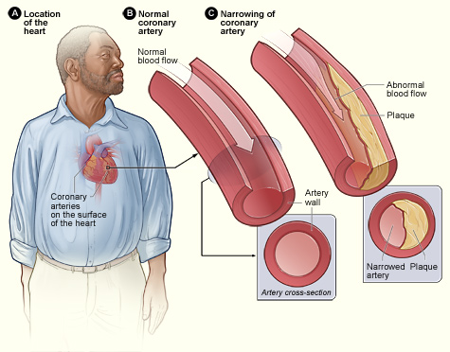
Plaque is made up of cholesterol, fat, calcium, and other substances found in the blood.

Slide 35
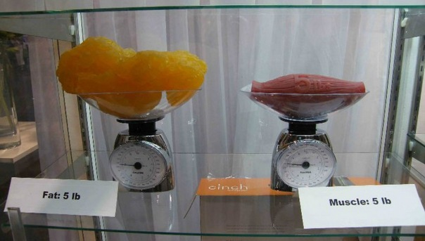

Fat Vs Muscle

Slide 36
Reduce Blood Sugar
The American Heart Association considers diabetes one of the
six major controllable risk factors for cardiovascular disease. In
fact, adults with diabetes are two to four times more likely to
have heart disease or a stroke than adults without diabetes.
Diabetes is treatable but even when glucose levels are under
control it greatly increases the risk of heart disease and stroke.
In fact, most people with diabetes die of some form of heart or blood vessel disease.

Slide 37
American Heart Association Guidelines
When diabetes is detected, a doctor may prescribe changes in eating habits, weight control, exercise programs and medication to keep it in check. It's critical for people with diabetes to have regular check-ups.
Work closely with your healthcare provider to manage your diabetes and control any other risk factors. For example, blood pressure for people with diabetes should be lower than 130/80 mm Hg.

Slide 38
Control your portion size
How much you eat is just as important as what you eat. Overloading your plate, taking seconds and eating until you feel stuffed can lead to eating more calories, fat and cholesterol than you should.

Slide 39
Portions
Portions served in restaurants are often more than anyone needs. Keep track of the number of servings you eat — and use proper serving sizes — to help control your portions.

Slide 40
Portions
Eating more of low-calorie, nutrient-rich foods, such as fruits and vegetables, and less of high-calorie, high-sodium foods, such as refined, processed or fast foods, can shape up your diet as well as your heart and waistline.

Slide 41
Portions
A serving size is a specific amount of food, defined by common measurements such as cups, ounces or pieces. For example, one serving of pasta is 1/2 cup, or about the size of a hockey puck. A serving of meat, fish or chicken is 2 to 3 ounces, or about the size and thickness of a deck of cards. Judging serving size is a learned skill. You may need to use measuring cups and spoons or a scale until you're comfortable with your judgment.

Slide 42
Eat more vegetables and fruits
Vegetables and fruits are good sources of vitamins and minerals. Vegetables and fruits are also low in calories and rich in dietary fiber. Vegetables and fruits contain substances found in plants that may help prevent cardiovascular disease. Eating more fruits and vegetables may help you eat less high-fat foods, such as meat, cheese and snack foods.

Slide 43
Vegetables & Fruit
Featuring vegetables and fruits in your diet can be easy. Keep vegetables washed and cut in your refrigerator for quick snacks. Keep fruit in a bowl in your kitchen so that you'll remember to eat it. Choose recipes that have vegetables or fruits as the main ingredient, such as vegetable stir-fry or fresh fruit mixed into salads.

Slide 44
Fruits and vegetables to choose
Fresh or frozen vegetables and fruits
Low-sodium canned vegetables
Canned fruit packed in juice or water

Slide 45
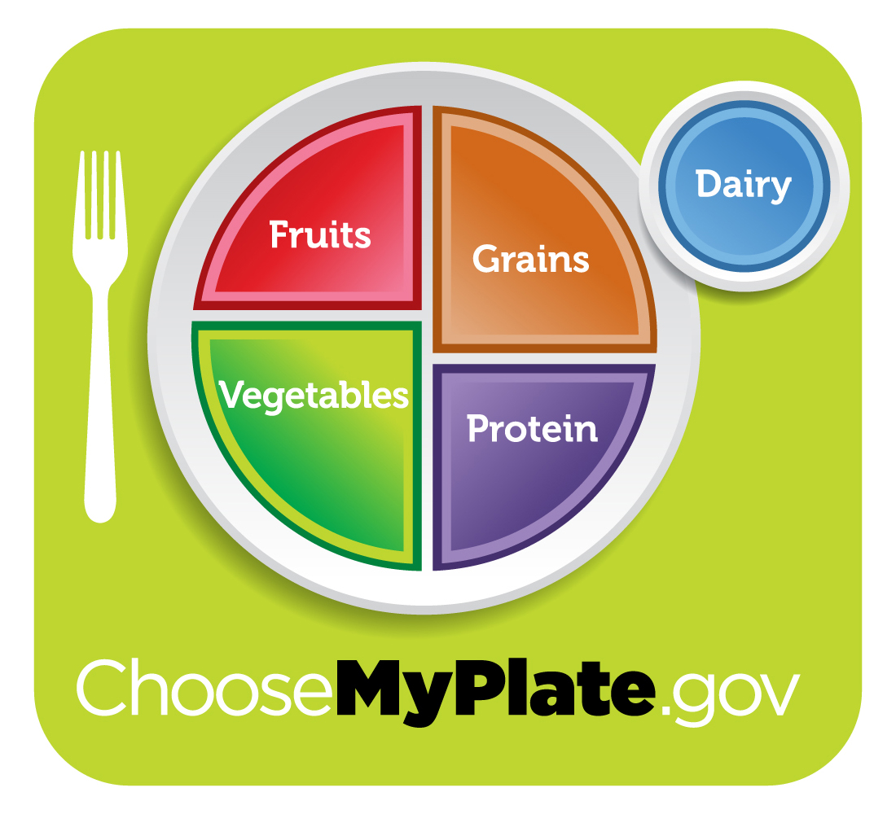
http://choosemyplate.gov/

Slide 46
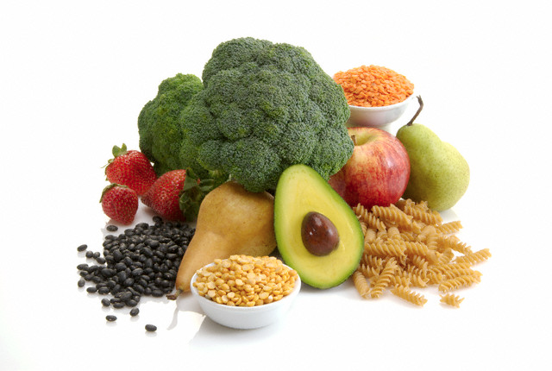
Good fiber
Brown rice
Quinoa
Crushed flax seed
Beans
Broccoli
Apples

Slide 47
Meal planning and recipes
http://www.diabetes.org/mfa-recipes/meal-plans/2014-01-mp-gluten-free.html
http://www.toscareno.com/
http://bodyforlife.com/library/recipes#pg-1
www.lizjones.org
https://www.facebook.com/liz.jones.1441810

Slide 48
www.lizjones.org

